Slide 1
Unit II – Leadership Skills
Chapter 2 - Leadership
Section 1 – Leadership Behavior and Styles

Slide 2
Understand the principles of leadership and how you can become a successful leader

Slide 3
Discuss the two orientations to leadership behavior
Define the four leadership styles
Identify the primary factors of the leadership situation

Slide 4
Key Term Questions Slide Index
Click any link below to go directly to polling that question.
Leadership model, no best way to lead people
Leader's engagement in two-way team member communication
Ability to understand the feelings of others
Leader's involvement in defining the individual or a group duties
Click here to return to this index.

Slide 5
Team Assignment
Alpha
Bravo
Charlie
Delta

Slide 6
A leadership model based on the concept that there is a no single best way to influence and lead people
Situational Leadership
Empathetic Leadership
Relationship Behavior
Task Behavior
1
1
1
1
(NS1-U2C2S1:KT1)

Slide 7
A leader's engagement in the supportive, two-way communication with his or her team members
Situational Leadership
Empathetic
Relationship Behavior
Task Behavior
1
1
1
1
NS1-U2C2S1:KT2)

Slide 8
Having the ability to understand; being aware of, and sensitive to, the feelings, thoughts and experiences of others
Situational Leadership
Empathetic
Relationship Behavior
Task Behavior
1
1
1
1
(NS1-U2C2S1:KT3)

Slide 9
The leader's involvement in defining the duties and responsibilities of an individual or a group
Situational Leadership
Empathetic
Relationship Behavior
Task Behavior
1
1
1
1
(NS1-U2C2S1:KT4)

Slide 10
Key Terms
Situational
A leadership model based on
Leadership -
the concept that there is no
single best way to influence
and lead people
Relationship
A leader’s engagement in
Behavior -
supportive, two-way
communication with his or
her team members

Slide 11
Key Terms
Empathetic -
Having the ability to
understand; being aware of,
and sensitive to, the feelings,
thoughts and experiences of
others
Task behavior -
The leader’s involvement in
defining the duties and
responsibilities of an
individual or a group

Slide 12
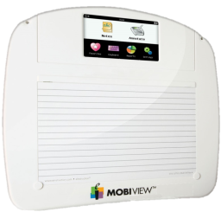
Describe the personality traits of a good leader.
1.
2.
3.
Note to Instructors:
Click the Show/Hide Response Display Button

Slide 13
How would you rate your CURRENT ability as a leader?
Very high - I see myself as a natural leader; AND I have had the chance to practice leadership skills.
High - I see myself as a natural leader; BUT I have not had many opportunities to practice these skills yet.
Moderate - I am unsure if I have the skills of a leader; BUT I am excited for the opportunity to learn and practice.
Low - I am unsure if I have the skills of a leader; AND I am a bit nervous about being put in a leadership role.
1
1
1
1
(NS1-U2C2S1:LQ1)

Slide 14
Leadership and management are essentially the same thing.
True
False
(NS1-U2C2S1:LQ2)

Slide 15
Leadership Skills
Anyone can become a good leader with a desire to acquire those skills, and some practice.
Leadership is different from management.
Leadership
The art of influencing and directing people to accomplish the mission
Management
Supervising the use of resources to achieve team objectives
In short… you lead people, and you manage things.

Slide 16
Leadership Skills
A leader should tailor his approach based on the environment and the readiness of his team to tackle the challenge.
Readiness = degree to which a follower demonstrates the ability and willingness to accomplish the task
This is called situational leadership.

Slide 17
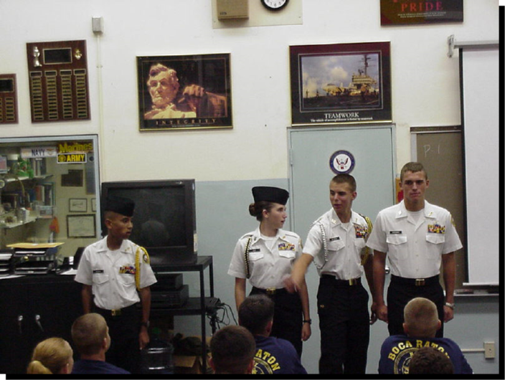
Leadership Skills
About situational leadership:
It is flexible in nature
Based on abilities, knowledge, skills and motivation level of the team members
Requires that leader know his/her people and their skills well
Might look different if the leader was more oriented toward people versus toward the task

Slide 18
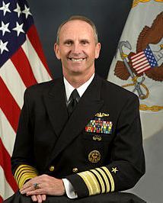
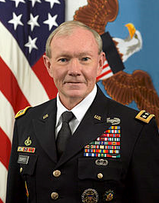
A Leader’s Orientation
Toward People
focuses on interaction with his/her people and uses this to complete the task;
“relationship
behavior”
Toward the Task
focuses on the job to be done and how to best
use his/her
people to
that end;
“task behavior”
Admiral
Jonathan Greenert (CNO)
General Martin Dempsey, Chairman JCS

Slide 19
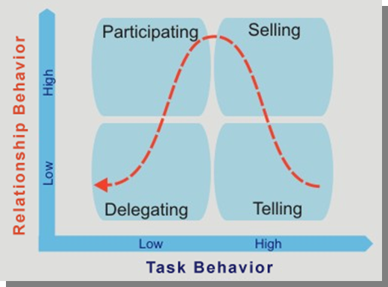
Four Leadership Styles

Slide 20
Four Leadership Styles
 |  | Style 1 Telling | Style 2 Selling | Style 3 Partici-pating | Style 4 Dele-gating
Relationship Orientation | High |  | X | X
 | Low | X |  |  | X
Task Orientation | High | X | X
 | Low |  |  | X | X
Leadership
Grid shows
distinct but complementary leadership behaviors

Slide 21
Four Leadership Styles
 |  | Style 1 Telling | Style 2 Selling | Style 3 Partici-pating | Style 4 Dele-gating
Relationship Orientation | High |  | X | X
 | Low | X |  |  | X
Task Orientation | High | X | X
 | Low |  |  | X | X
Telling Style
behaviors:
Directing others
Supervising them closely
Following up to ensure task completion

Slide 22
Four Leadership Styles
 |  | Style 1 Telling | Style 2 Selling | Style 3 Partici-pating | Style 4 Dele-gating
Relationship Orientation | High |  | X | X
 | Low | X |  |  | X
Task Orientation | High | X | X
 | Low |  |  | X | X
Selling Style
behaviors:
Closely supervises
Explains relationships between tasks and goals
Encourages questions

Slide 23
Four Leadership Styles
Participating Style
behaviors:
Offers ideas for tasks
Shares responsibility for decision-making
Allows others to structure their tasks as they like
 |  | Style 1 Telling | Style 2 Selling | Style 3 Partici-pating | Style 4 Dele-gating
Relationship Orientation | High |  | X | X
 | Low | X |  |  | X
Task Orientation | High | X | X
 | Low |  |  | X | X

Slide 24
Four Leadership Styles
 |  | Style 1 Telling | Style 2 Selling | Style 3 Partici-pating | Style 4 Dele-gating
Relationship Orientation | High |  | X | X
 | Low | X |  |  | X
Task Orientation | High | X | X
 | Low |  |  | X | X
Delegating Style behaviors:
Responsibility passed to team for
Decision-making
Problem-solving
Imple-menting

Slide 25
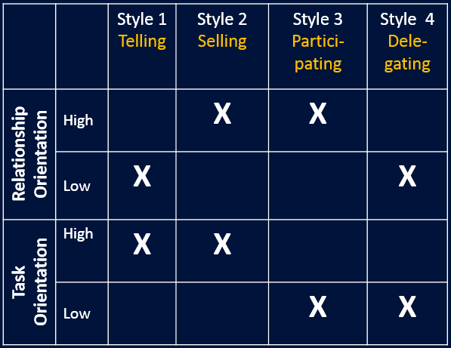
Which of the following Leadership Styles do you think most closely represents your natural style?
Telling
Selling
Participating
Delegating
1
1
1
1
(NS1-U2C2S1:LQ3)

Slide 26
You have accepted the leadership role of running a group of volunteers for an after-school reading program for elementary students. The volunteers are high school students who seem unsure of their abilities and may need a lot of encouragement. Which leadership style do you think you will need to adopt?
Telling
Selling
Participating
Delegating
1
1
1
1
(NS1-U2C2S1:LQ4)

Slide 27
Leadership Etiquette
Successful leaders:
Make decisions that will enhance all, not just themselves
Realize that they also have superiors to whom they are accountable
Serve as examples of fair play, integrity and dependability
Listen to the needs, feedback and suggestions of all
Understand that leadership is about ___________, not just glory or popularity
responsibility

Slide 28
Leadership Etiquette
Successful leaders:
Roll up their sleeves and help others when the going gets tough
Know that they succeed only with the work, _______ and dedication of others
Do not seek personal recognition but share it equally with their team
Work for the success of the organization, not personal gain
Know that they are entrusted with leadership power, and they must continue to earn it or lose it
support

Slide 29
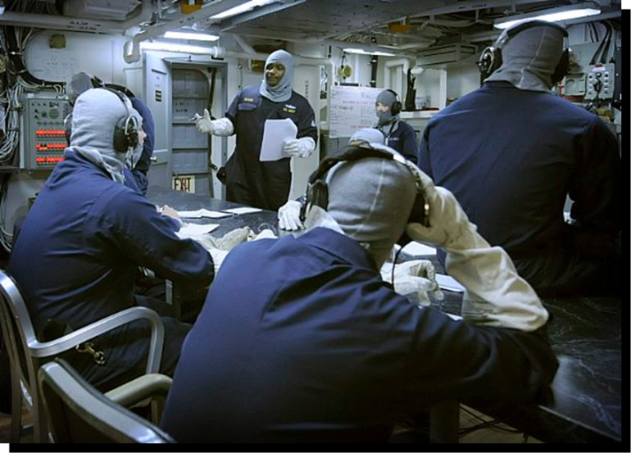
Primary Factors of the Leadership Situation
As a leader, you lead people and you manage things.
The team’s situation dictates how much time the leader spends on each above, considering the factors of:
Mission
People
Leadership style
Environment

Slide 30
The Mission
The leader typically defines the mission and sets goals for completing its tasks.
But the mission may instead be set by someone outside the team – meaning the leader must translate it into goals that ____ ________ will accept, understand and adopt as their own.
When possible, team members should help set goals.
team members

Slide 31
The Mission
The leader must also set standards of performance and make sure they are understood.
Standards should be
Reasonable
Supportive of mission
Clearly-defined
Consistently enforced among team members
Monitored by leader as project progresses

Slide 32
As a leader, you lead _____ and you manage _____.
things / people
people / things
(NS1-U2C2S1:LQ5)

Slide 33
Your principal has asked you to organize a group of NJROTC cadets to pick up trash along a highway near your school next Saturday morning. Nobody seems very excited about the job, so, as the leader, you should…
pressure the group into doing a good job by threatening them with negative consequences if they don't participate.
get the principal to persuade the cadets to sign up by writing a letter explaining the importance of keeping the highway clean.
tell the group you will buy donuts in the morning.
have a meeting with the group focused on exploring how this task might be personally beneficial to each cadet.
1
1
1
1
(NS1-U2C2S1:LQ6)

Slide 34
The People
Leaders must be sensitive to people and try to understand them. This helps leaders know what action to take as the follower’s ability level becomes clear.
Two elements of ability:
2. Experience – higher seniority or rank doesn’t mean person has specific experience needed. Some learn quickly; others need more time to acquire a skill.
1. Training – if it is inadequate, leader needs to make sure person get what is needed to perform task

Slide 35
The Leadership Style
Successful leaders adapt their leadership style to suit the mission and their team members.
But everyone has strengths and __________, so the wise leader knows how to accommodate both.
weaknesses
For example, if you are a good oral communicator, have face to face conversations .

Slide 36
The Leadership Style
Successful leaders adapt their leadership style to suit the mission and their team members.
But everyone has strengths and __________, so the wise leader knows how to accommodate both.
weaknesses
Or, if you are more comfortable with written communication, use that to exchange thoughts and ideas.

Slide 37
The Leadership Style
Successful leaders must also make sure their leadership style corresponds to their team members’:
Knowledge
Abilities
Skills
After assessing the team members’ readiness, the leader may need to:
Guide and or support them
Motivate them
Give them freedom to proceed independently

Slide 38
The Environment
A leader can prepare for the unexpected by giving careful consideration to the whole environment.
Change is happening constantly, and it’s important to stay aware and monitor all aspects of the situation.
Leaders must alter and adapt
their _________ _______
accordingly as changes occur.
Flexibility is key!
leadership behavior

Slide 39
Having higher seniority or rank typically means the person has the specific experience or skill that is needed to complete a mission.
True
False
(NS1-U2C2S1:LQ7)

Slide 40
Exercise and nutrition are to good health as _________ and ________ are to good leadership abilities.
sensitivity and flexibility
intelligence and charisma
physical strength and speaking ability
gender and focus
1
1
1
1
(NS1-U2C2S1:LQ8)

Slide 41
List 2-3 things that are similar OR different between the four leadership styles.
1.
2.
3.
Note to Instructors:
Click the Show/Hide Response Display Button

Slide 43
Leaderboard
Last
Slide
Points | Participant | Points | Participant

Slide 44
Team Scores
Last
Slide
Points | Team | Points | Team

Slide 45
Team MVP
Last
Slide
Points | Team | Participant

Slide 46
Whiteboard
Last
Slide

